Slide 1
Analysis of APIT
Enrique Alejandro Gutierrez B

Slide 2
Performance of APIT algorithm
Possible approach to improve APIT algorithm
Noise model assumed (DOI)
Results

Slide 3
Analysis of the upper bound of achievable accuracy of APIT (no noise, and perfect circular radio propagation model). Code finished and some simulations have been run
Parameters defined by authors of APIT: R, ANR, ND, AP, AH. (rather than defining M-># of blindfolded devices and N-># of anchors).

Slide 4
Analysis of anchor placement strategies.
  Even deployment at the edges of terrain
  Random deployment at the edges of terrain
  Uniform deployment inside terrain
  Random deployment inside terrain
Study these cases in order to visualize in which scenarios we may obtain the minimum average location error and avoid situations of maximum location error

Slide 5
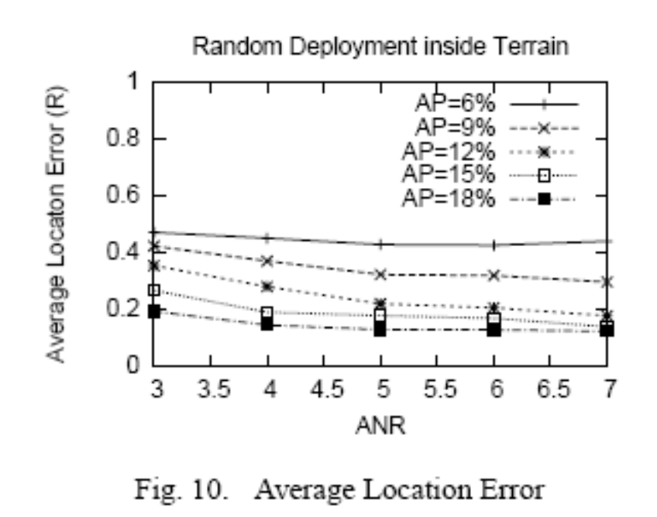
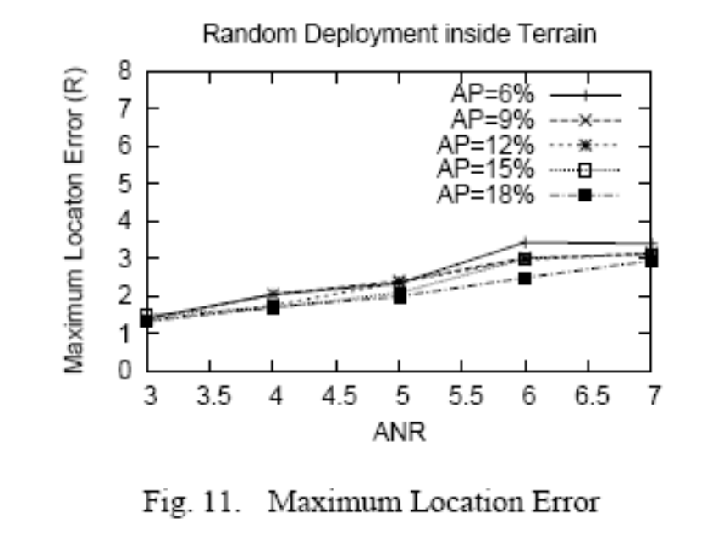

Slide 6
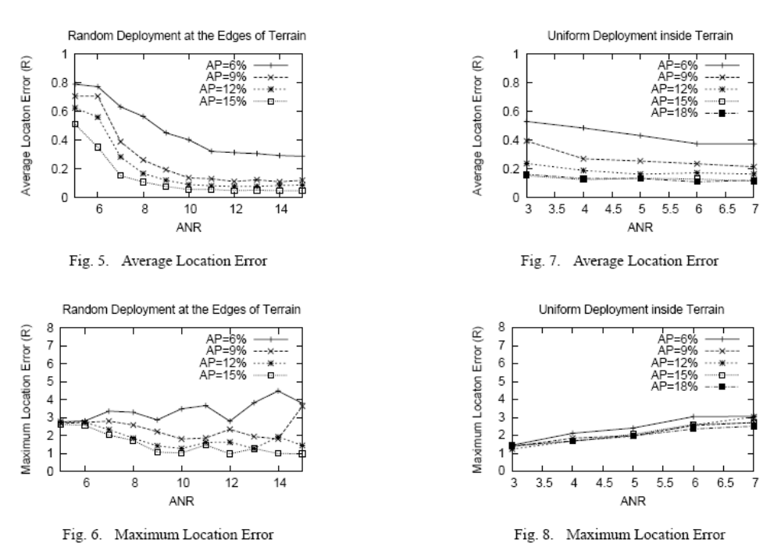

Slide 7
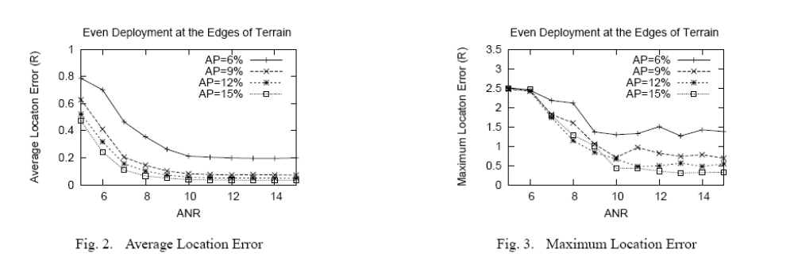
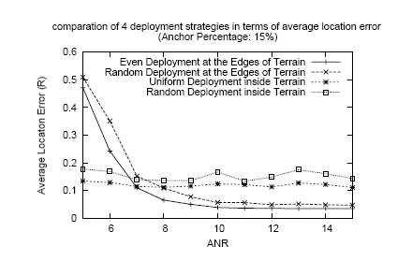

Slide 8
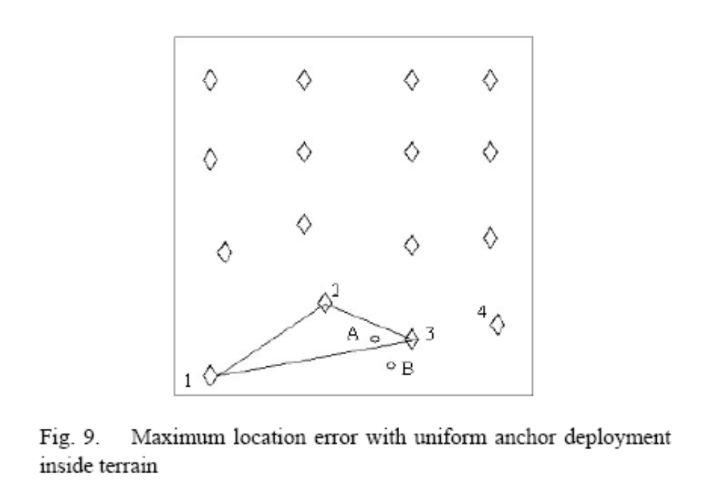
Undetermined nodes in APIT: nodes that do not listen to at least three anchors or nodes that do not fall within any triangle formed by audible anchors.

Slide 9
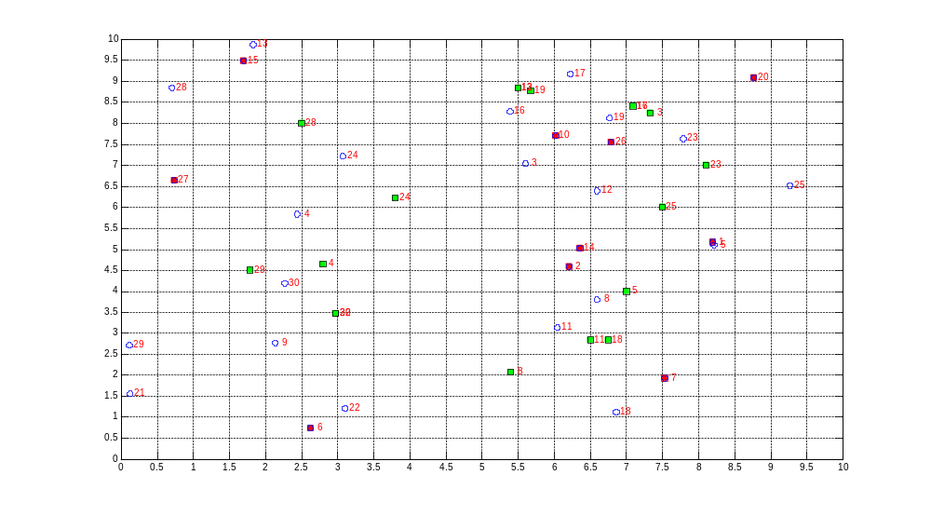
AH=9.6 ND=13.30 (30 nodes) M=20 N=10 ANR=1 R=4.58 DOI=0
RMSE 1.90497997[m]

Slide 10
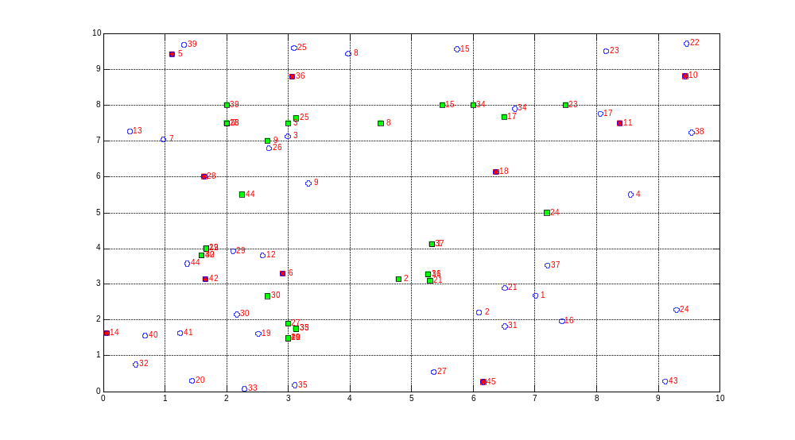
AH=4.65 ND=7.46 (45 nodes) M=35 N=10 ANR=2 R=2.8 DOI=0
RMSE 1.82762167[m]

Slide 11
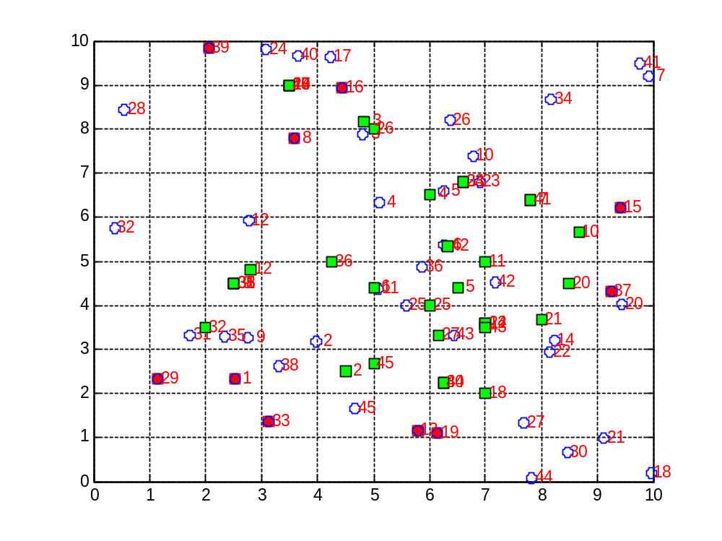
AH=5.45 ND=7.77 (45 nodes)
M=35 N=10 ANR=2 R=2.8 DOI=0
RMSE 1.96018081[m]

Slide 12
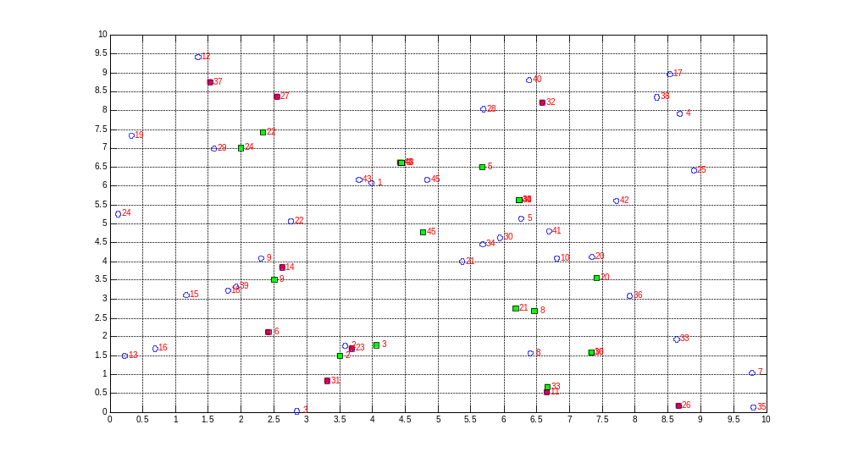
AH=5.92 ND=8.22 (45 nodes) M=35 N=10 ANR=2 R=2.8 DOI=0
RMSE 1.57334131 [m]

Slide 13
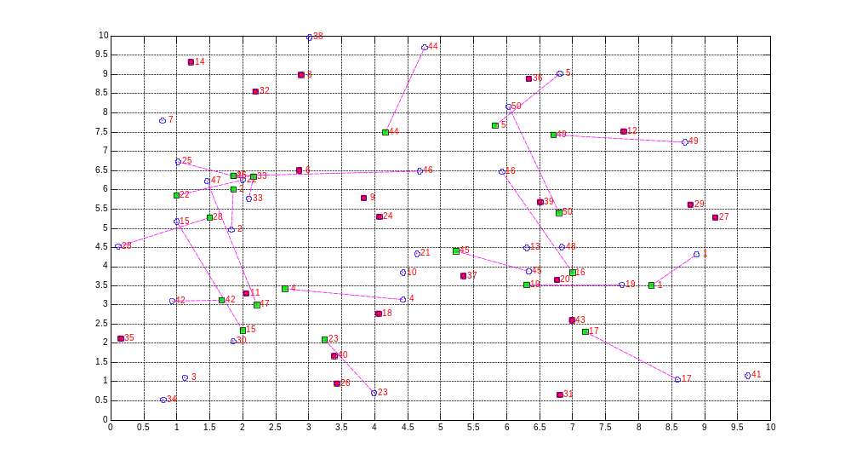
AH=9.8 ND=23.2 (50 nodes) M=30 N=20 ANR=1 R=4.58 DOI=0
RMSE 1.9549052[m]

Slide 14
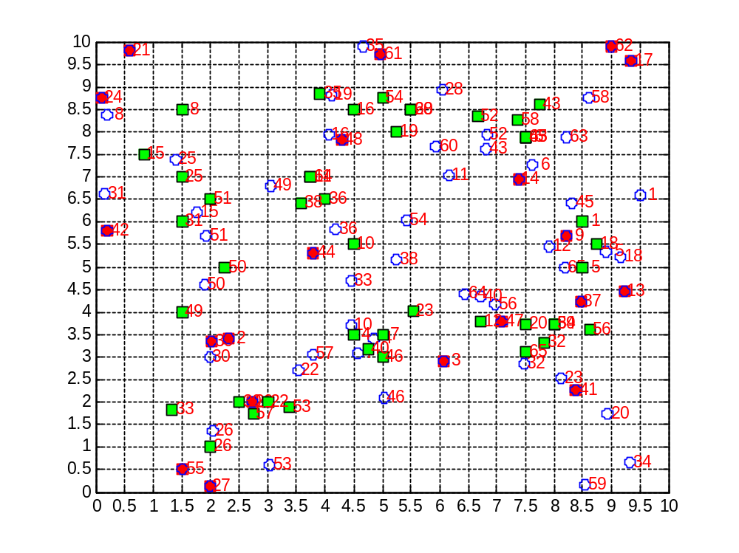
AH=11.46 ND=13.04 (65 nodes) M=45 N=20 ANR=2 R=2.8 DOI=0
RMSE 1.82813523[m]

Slide 15
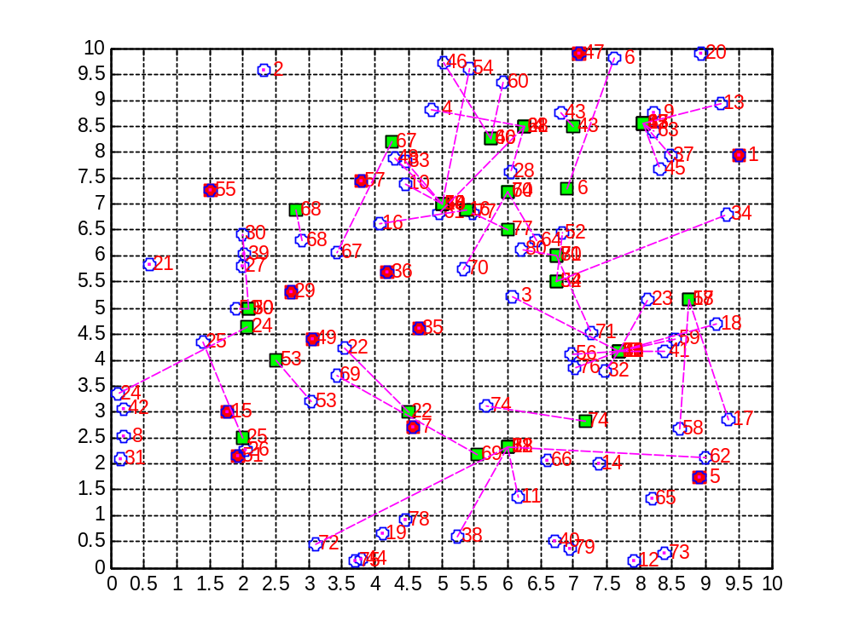
AH=12 ND=8.3 (80 nodes) M=68 N=12 ANR=6 R=2 DOI=0
RMSE 1.6336[m]

Slide 16
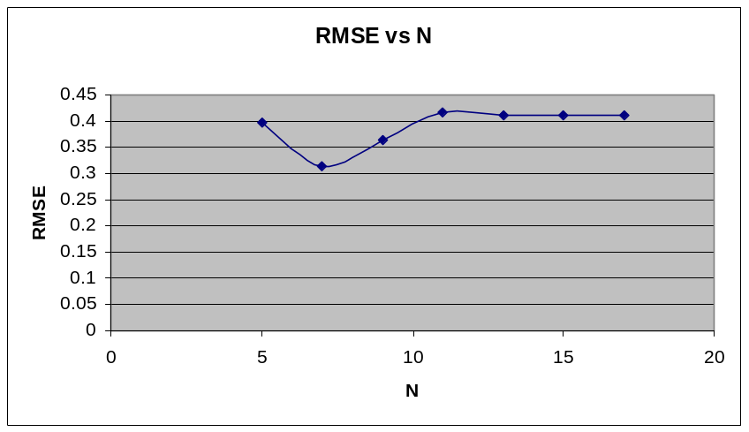
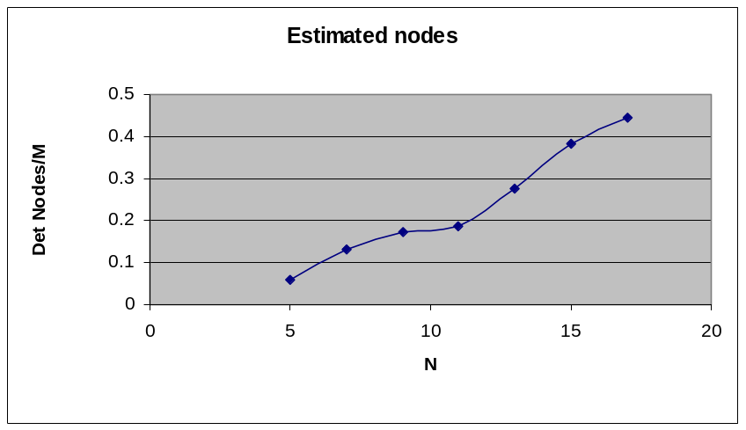
APIT considering one simulation run
M=30, ANR=1, R=4.58m, Res_Grid=0.5m, Grid=[0 10m], DOI=0 (i.e. perfect –
Circular radiation), Random deployment of M and N
Note: Each point represents the average of ten simulation runs in Matlab

Slide 17
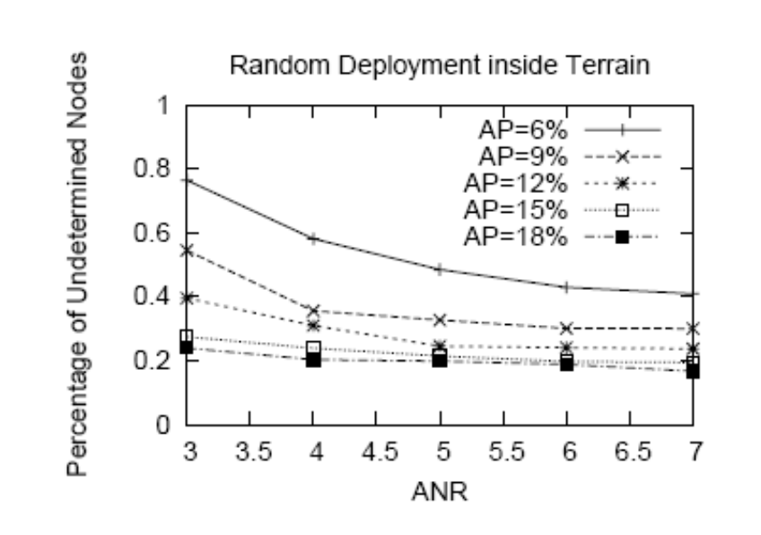
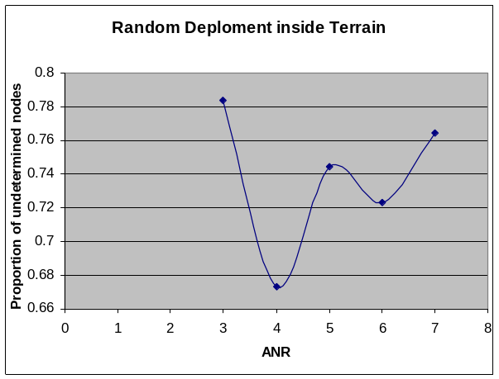
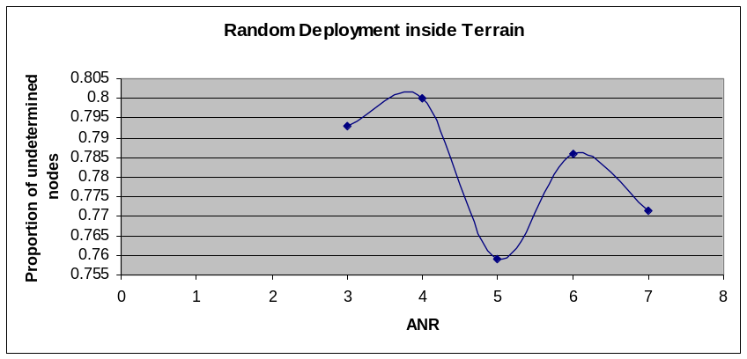
Undetermined nodes problem
M=60 N=4 AP=6% Res=0.5 Grid [0 10] ND~8 R=2.2
Grid [0 10R]
ND~8
Res (unknown)
M=60 N=4 AP=6% Res=1 Grid [0 20] ND~8 R=4.2

Slide 18
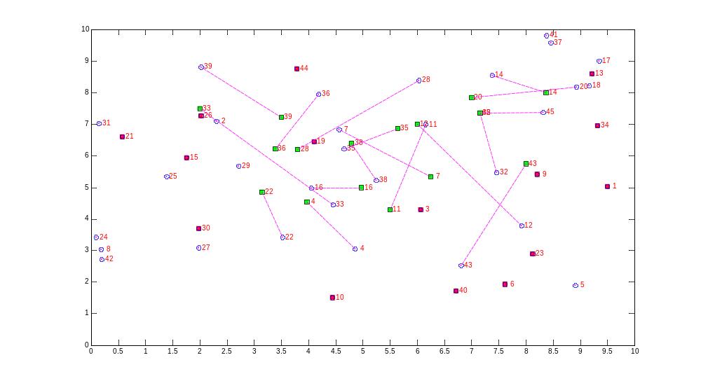
APIT + = APIT considering two simulation runs
M=30, N=15, ANR=1, Res=0.5, R=4.58, Grid [0 10]
Error 1st run: 2.1762 m
New estimated positions: {12, 16, 20, 36, 43}->Error 2nd run: 2.6144 m

Slide 19
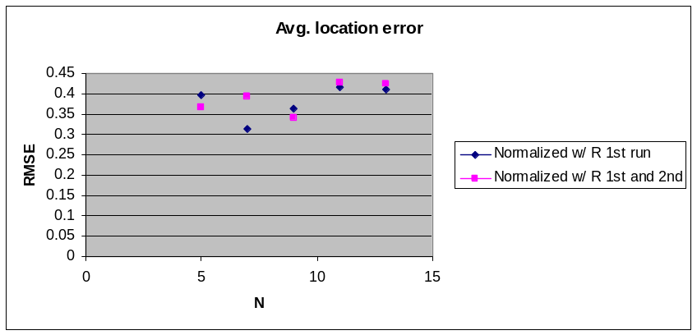
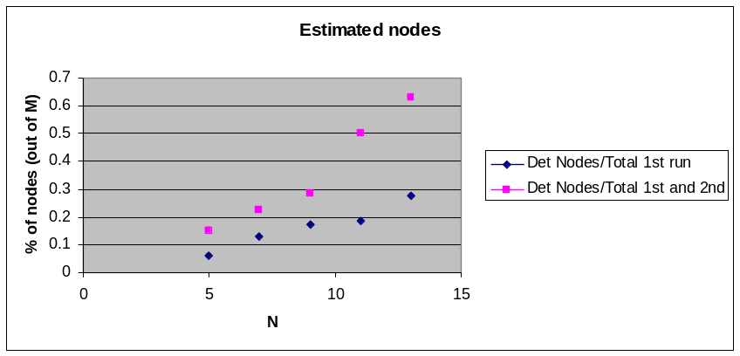
Advantages APIT +
We may increase the number of estimated nodes
We may use fewer anchors at the beginning of the algorithm
What about the avg. location error?

Slide 20
We can increase Res_Grid (~0.1R) to get better accuracy and try to replicate some graphs assuming a Grid [0 10R], however it will take much more time in order to run just one trial.
Idea: Visualize a particular scenario (~an anchor deployment strategy) to get a minimum avg. location error, from there we may use the estimated nodes as anchors in order to compute the location of the remaining nodes.
  Cons: We are fixing the strategy for allocating anchor nodes
  Pros:
    Alleviate the “undetermined nodes” problem of APIT
    We know which nodes are closed to a hole in connectivity since they probably will not fall inside of any triangle or they do not have any audible anchors at all.

Slide 21
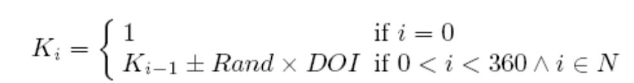
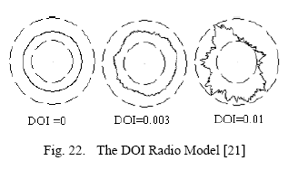
DOI Model and DOI extended model
Radio propagation exhibits non-isotropic path losses (~radio signal
Attenuation may be different along different directions).
DOI Model: Assume an upper bound and lower bound, within these bounds
the RSS at certain point is described as:
RSS=Sending Power-DOIAdjusted+Fading
Where DOIAdjusted=PathLoss*Ki (Ki represents the difference in path loss in
Different directions)
DOI= Degree of Irregularity. Maximum range variation per unit degree change
In the direction of radio propagation

Slide 22
DOI (extended). Do not assume any lower bound of radio irregularity. (condition very harsh for localization algs).
RSS=C*Ki/d^2, (d is the distance between the sender and the receiver < maximal radio range of the sender )
Is it a good idea to define thresholds based on distances for the DOI model?

Slide 23
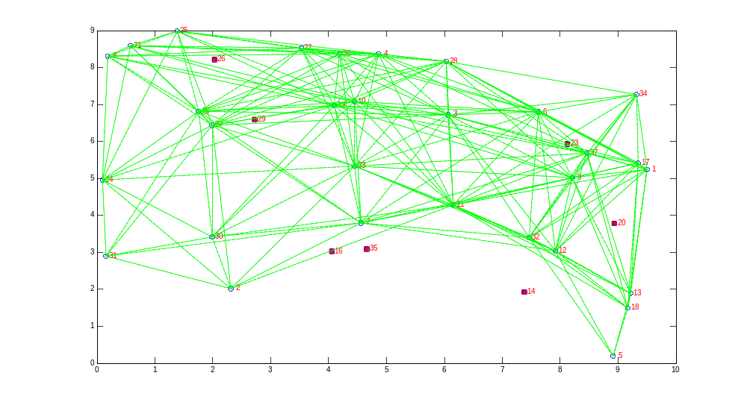
Application for APIT +
Gateway
(info goes
through another
ntwk or source)
Disaster area (e.g. fire)->constitutes an anisotropic
area. We should know the positions of more
nodes than those obtained from APIT. From here,
we can have several paths in order to deliver the
information with the minimum delay and using the
minimum energy (QoS and reliability), we may possible route the info through
high power nodes in order to deliver the info. faster {threshold
between power and delay}
Beacon nodes
(possibly,
high power nodes
If ANR>1)

Slide 24
Remarks
Loc algs. may be evaluated in conditions in order to know if practical apps can be run over them such as fault-tolerance, scalability, energy consumption {from mathematical models > to physical metrics (e.g. bandwith)}
We should increase the number of estimated nodes (in case of hw failure). Thus, we can still have available nodes and apps such as routing may have enough paths to route info.
DOI work with sensitivity of the node instead of a threshold distance?
The ND highly affects the decision that a node falls inside or outside of a triangle
Small sensors have limited Sensing Range (i.e. R is small) which requires closer spacing and reduces transmission power needs (alleviate the problem of the energy consumption of the network) and the ND can be reduced (until which point in order to make a good PIT test????)

